Slide 1


Car Loans Default Dataset OPIM 5512 – Data Science Using Python
Team 6 – Kevin Sichanh, Sana Khan, Pranjal Jain, Datta sai kumar Katiki, Charan Papioti, Abhishek Garakurthi

Slide 2
Introduction to the Project
NBFIs (non-banking financial institution) are struggling to mark profits due to an increase in defaults in the vehicle loan category. These organizations aim to determine the client’s loan repayment abilities and understand the relative importance of each parameter contributing to a borrower’s ability to repay the loan.
The goal of the problem is to predict whether a client will default on the vehicle loan payment or not. Which will be predicted on based on the “Default” value.

Slide 3
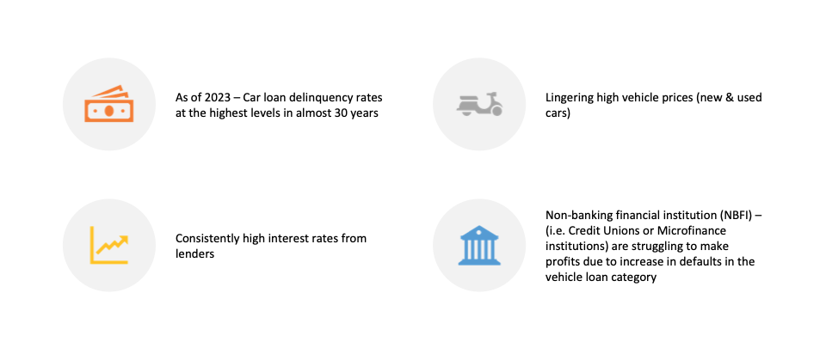
Why is the problem important
Notes:
The last time this many drivers were delinquent on their auto loans was when the first mobile flip phone entered the market — in October of 1996. That’s according to new data from Fitch Ratings examining the percentage of borrowers at least 60 days past due on their loans in 2023’s third quarter.
And some borrowers are at a higher risk than others. Here’s what caused this surge and how to decrease your risk of falling behind on your loan.

Slide 4
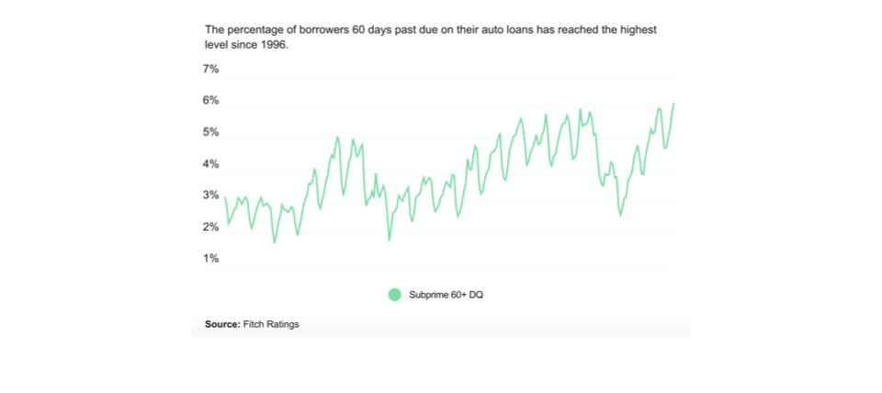
Subprime auto loan delinquency
Notes:
What’s driving the surge?
Two primary factors contributed to growing delinquency rates. First is lingering high vehicle prices, and the second is high interest rates.
Vehicle prices have dropped slightly since this time last year. Used prices are down 4 percent and new, just over 1 percent, according to Kelley Blue Book. But these prices are still dramatically above pre-pandemic levels.
These high prices could serve as a problem on its own, but combined with high interest rates borrowers, it is unspringing that borrowers are struggling to make monthly payments.
Despite the higher prices, subprime drivers in 2022’s third quarter had slightly lower average monthly payments than they do now, thanks to lower interest rates.
A few factors drive the interest rate that borrowers receive. These include credit background, vehicle price, the down payment and macroeconomic factors that impact lenders’ borrowing costs. Rates are up year over year for drivers across the credit spectrum.

Slide 5
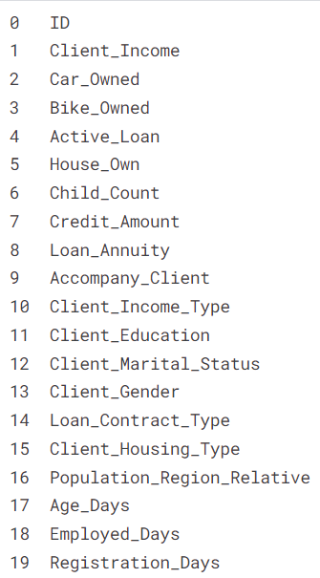
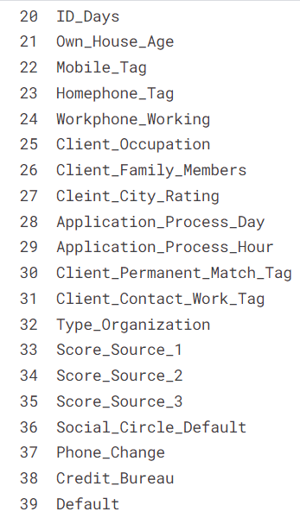
Dataset Description
40 columns
121,856 rows

Slide 6
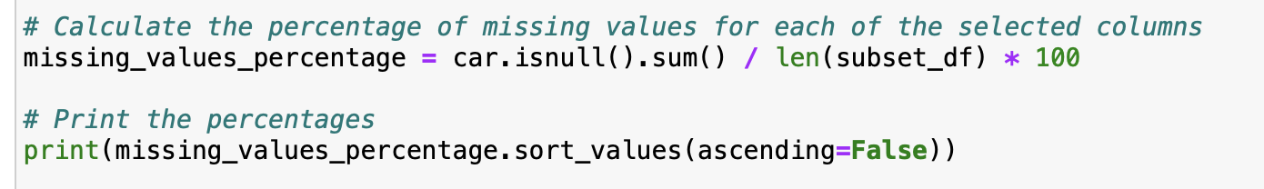
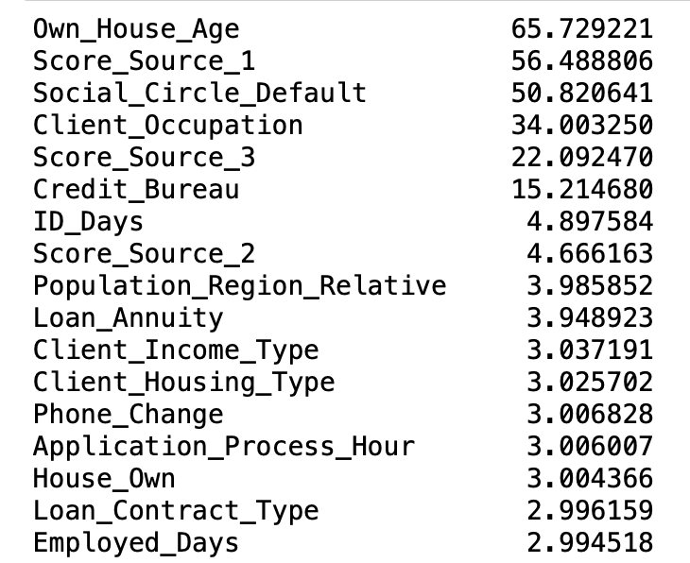
Data Cleaning and Preprocessing
Missing Values
Top columns with missing values
Columns removed
ID
Own_House_Age
Score_Source_1
Score_Source_2
Score_Source_3
Social_Circle_Default
Mobile Tag
Notes:
Exploratory for eda , how much percentage of data missing , if percentage less than 5% we did mean , median , mode
More than 5% , we imputed by making a new category
More than 40 % we dropped them.
Issue of the oversampling.
We checked the value counts

Slide 7
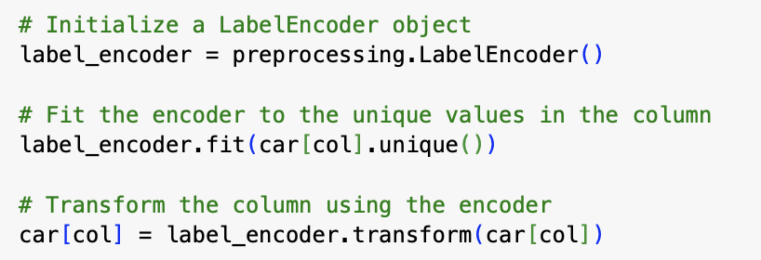
Exploratory Data Analysis(EDA)
Imputation
Label encoding
Less than 5% - imputation using mean, median, mode for missing values.
5 -40% - a new category is created to accommodate it, preserving information while preventing distortion.
Above 40%,- the corresponding entries are dropped to maintain dataset integrity.
Label encoding converts categorical variables to numerical labels, allowing machine learning algorithms to interpret and process the data more effectively.
Notes:
In the realm of machine learning, categorical variables are often transformed into numerical form to ensure compatibility with algorithms that inherently operate on numeric inputs. Label encoding is a technique applied to convert these categories into numerical labels, thereby enhancing model performance and interpretability by allowing the algorithm to process data in its requisite numerical format.

Slide 8
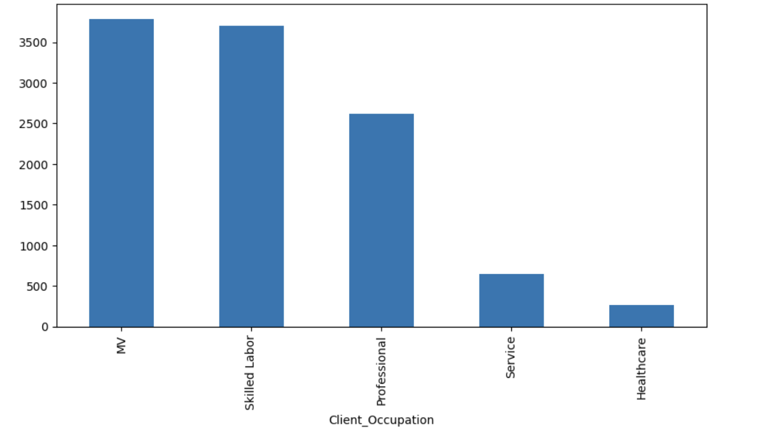
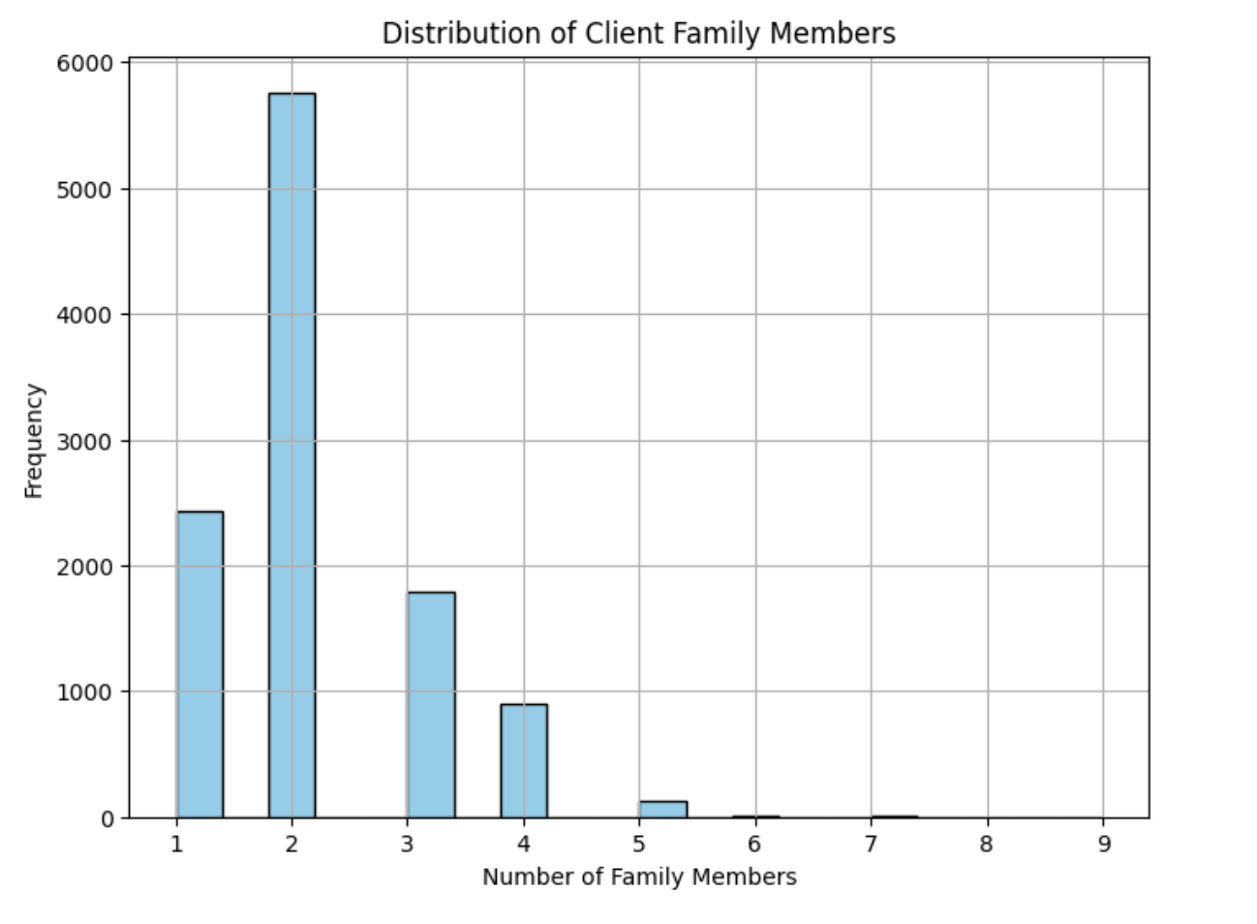
Exploratory Data Analysis(EDA)
Client_Occupation(34%)
Client_family_members(2%)

Slide 9
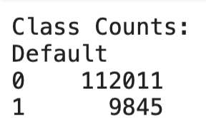
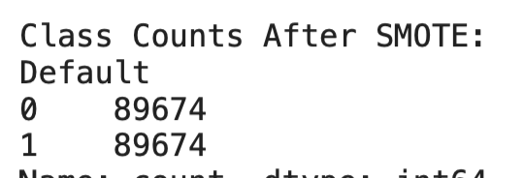
Exploratory Data Analysis(EDA)
Class Imbalance
SMOTE
SMOTE
Enhances minority class representation via synthetic data generation.
Synthesizes new examples by interpolating between existing minority instances and their nearest neighbors.
Achieves a more balanced class distribution, essential for unbiased model training.

Slide 10
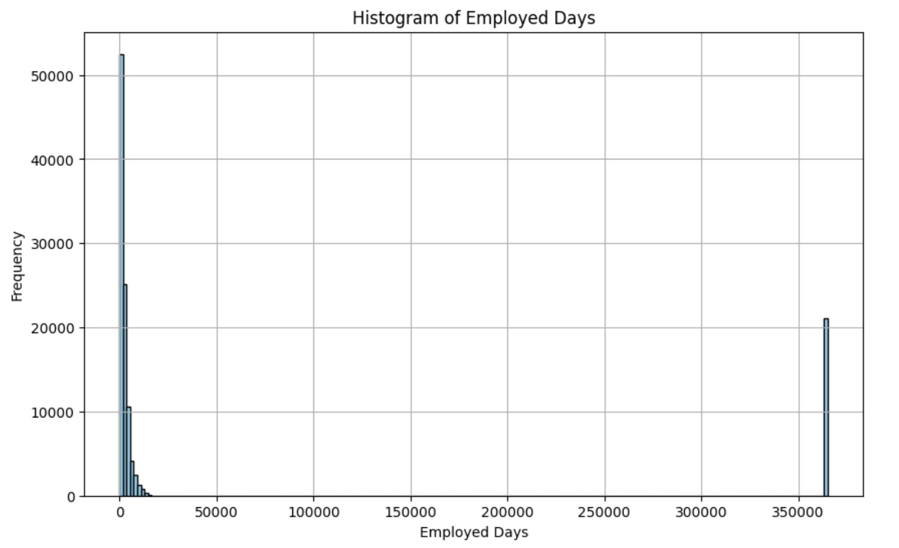
Exploratory Data Analysis(EDA)
Outlier detection and management
To counter, outliers we removed the outlier values and replaced the removed values with median of the majority data i.e. days< 20000

Slide 11
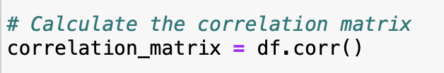
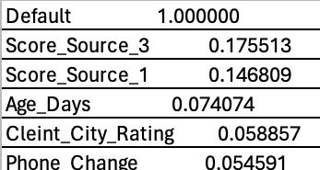
Model Selection
Checked for correlation analysis for numerical variables.
Top columns correlated to default
The highest correlation coefficient observed is 0.17, indicating only a very weak correlation. Consequently, logistic regression, which relies on the strength of linear relationships, may not be suitable for our analysis and will be excluded from consideration.
Notes:
Ours is a classification model , after checking data cleaning. We checked correlation of numeric variables, and the values were 0.5 , our data had 0.1. That’s why we dropped logistic regression.
So we went ahead with decision tree , random forest , xgboost which are all classification models

Slide 12
Model Selection
Our dataset includes a mix of numerical and categorical variables, which necessitates the use of versatile classification models.
Traditional correlation analysis is less effective for categorical data; hence, we adopted models that can inherently process such diversity.
Finally, we implemented models robust in handling datasets with both numerical and categorical variables:
Decision Tree model
Random forest model
XG Boost model
Notes:
Ours is a classification model , after checking data cleaning. We checked correlation of numeric variables, and the values were 0.5 , our data had 0.1. That’s why we dropped logistic regression.
So we went ahead with decision tree , random forest , xgboost which are all classification models

Slide 13
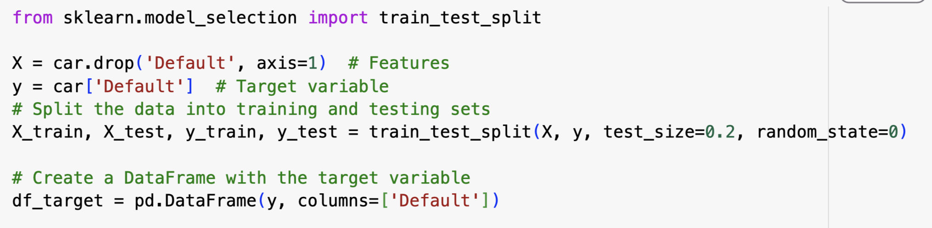
Data partition based on cleaned dataset
We utilized the `train_test_split` method to divide our cleansed dataset, allocating 80% to the training set and reserving 20% for the testing set. This approach ensures that our model has a substantial amount of data to learn from while also providing an adequate portion for evaluation.
Notes:
We did train test split

Slide 14
Model Evaluation and Comparison
Model Name | Accuracy | ROC AUC | Misclassification rate | RMSE
Random forest | 0.922 | 0.70 | 0.077 | 0.277
XGB Boost | 0.916 | 0.69 | 0.083 | 0.288
Decision tree model | 0.62 | 0.63 | 0.376 | 0.613
Notes:
The results and other scores.

Slide 15
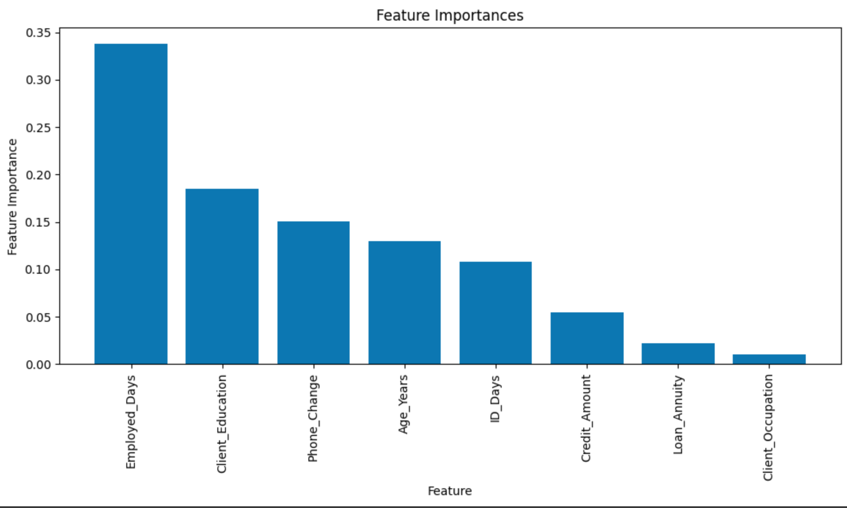
Findings (Decision Tree)
Employed days has the most feature importance here and makes the most impact on the model.
Filtered, the most impactful features with a filter of >0.05 for significance level.
Notes:
Employed days has the most feature importance here and makes the most impact on the model

Slide 16
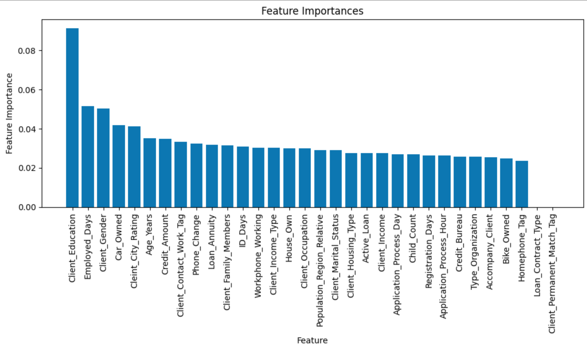
Findings (XGBoost)
The feature 'Client_education' holds the highest importance in our model, exerting the greatest influence on the predictive outcomes. Following it, 'Employed_days' ranks as the second most significant factor impacting the model's performance.

Slide 17
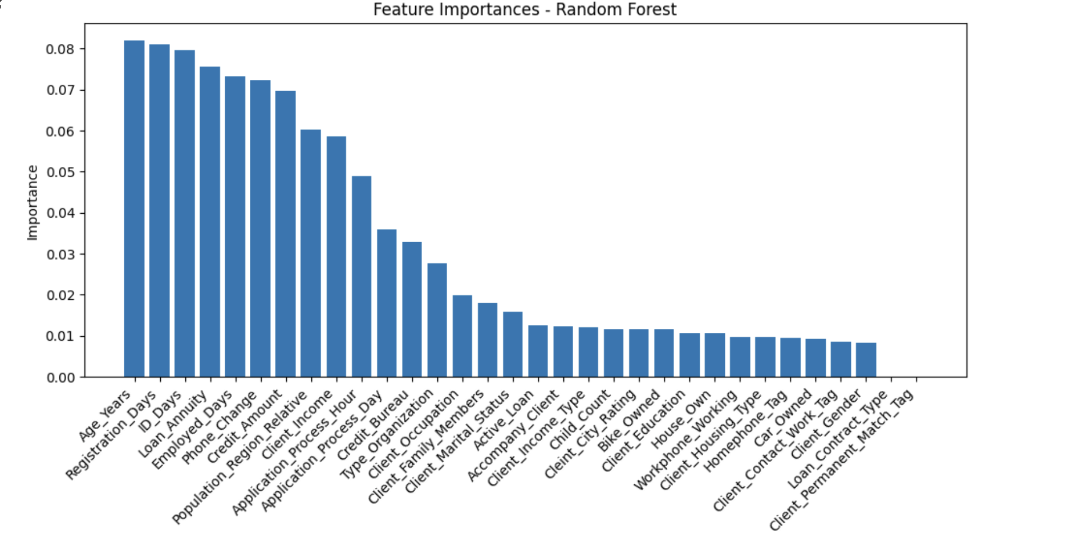
Findings (Random Forest)

Slide 18
Business Relevance of the Data
Higher income and longer employed days generally indicates a lower default risk as borrowers with higher incomes are more likely to make timely payments.
The number and size of existing loans can increase default risk, especially if the borrower's total debt burden is high.
Possessing valuable assets can reduce default risk as borrowers may have collateral to secure the loan (stronger credit history).
Factors such as employed days, client education, assets, and credit scores are critical inputs for evaluating borrower creditworthiness and predicting default probabilities.

Slide 19
Recommendations
Incorporate a wider range of factors beyond traditional credit scores, such as income stability, debt-to-income ratio, employment history, and asset verification.
Provide financial literacy programs and resources to help borrowers better understand loan terms, budgeting, and financial planning.
Develop early warning systems using predictive analytics to identify borrowers at risk of default before they miss payments.
Conduct periodic reviews of loan underwriting processes to ensure alignment with current market conditions and risk tolerance levels.

Slide 20
Conclusions and Implications
As a lender, navigating through the automobile loan industry can be complex as it oversees several factors.
Cars are one of the most valuable assets next to owning property - nearly everybody needs a means of transportation (this is a very busy market for lenders).
This industry can be directly correlated to the overall health of the economy with factors such as generally higher interest rates and increased pressure from higher costs of living.
NBFIs can use predictive modeling to better forecast default risk more accurately, enhance company portfolio strategies, and to better strengthen their programs towards loaners using this data.
Notes:
NBFI (non-banking financial institution)

Slide 21
Appendix
Auto loan default prediction based on Stacking model LingLing Zeng1a, Jin Sun 2b, Yi Min Zhou3c 1. School of Economics, Wuhan University of Technology, Hubei Wuhan, China. (2023)
Credit Card and Auto Loan Delinquencies Continue Rising; Notably Among Younger Borrowers (2023) https://www.bankrate.com/loans/auto-loans/subprime-auto-loan-delinquencies-surge/
Delinquency rates at highest level in almost 30 years (2024) https://www.newyorkfed.org/newsevents/news/research/2024/20240206
Automobile Loan Default Dataset (2022) https://www.kaggle.com/datasets/saurabhbagchi/dish-network-hackathon?select=Test_Dataset.csv

Slide 22

Questions?

